Slide 1
Transaction Exposure

Slide 2
Sections
Exposures
Forwards (and futures) hedge
Money market hedge
Options hedge
Swaps hedge
Operational hedge techniques

Slide 3
Exposure
Exposure: exposed (non-zero sensitivity) to risk.
Three types of FX exposure:
(1) Transaction exposure: the sensitivity of realized domestic currency values of the firm’s contractual cash flows denominated in foreign currencies to unexpected exchange rate changes.
(2) Economic exposure: the extent to which the value of the firm would be affected by unexpected exchange rate changes.
(3) Translation exposure (accounting exposure): the extend to which the firm’s consolidated financial statements would be affected by changes in exchange rates.

Slide 4
Transaction exposure
Whenever a firm has foreign-currency-denominated receivables or payables, it is subject to transaction exposure.
The sizes of these receivables or payables defines the magnitude of transaction exposure.
Thus, when a firm has no foreign-currency-denominated receivables or payables, it has no transaction exposure.

Slide 5
Hedging via financial contracts
The following financial contracts can be used to hedge transaction exposure:
(1) Forwards (and futures).
(2) Money market securities.
(3) Options.
(4) Swaps.

Slide 6
Hedging via operational techniques
The following operational techniques can also be used to hedge transaction exposure:
(1) Choice of the invoice currency.
(2) Lead/lag strategy.
(3) Exposure netting.

Slide 7
Scenario
Suppose that Boeing exported a Boeing jet to British Airways and billed £10 million payable in 1 year.
Non-$ receivable for Boeing ➔ transaction exposure.
This is so because the $ value of £10 million receivable in 1 year is subject to the $/£ FX risk in this coming year.

Slide 8
Forward market hedge
Strategy: the firm may sell (buy) its foreign currency receivables (payables) forward.
That is, Boeing sells forward its £10 million receivables for delivery in 1 year at current forward rate, say $1.46/£.
In 1 year, Boeing will deliver the received £10 million to the forward bank in exchange for $14.6 million (10 × 1.46).
Now the $14.6 million cash inflow in 1 year involves no FX risk.
Suppose that the spot rate in 1 year turns out to be $1.4/£. Boeing thus would receive $14 million had it not entered into the forward contract.
The ex post gain for forward hedging is $0.6 million.

Slide 9
Futures market hedge
Boeing can also choose to sell/short £ futures to hedge the FX risk.
But the hedge is likely to be “approximate” because futures are standardized and cannot tailor to Boeing’s hedging need, say matching the exact size of the exposure, maturity date, etc.
For this case, Boeing needs 160 CME contracts (standardized size £62,500) for £10 million exposure.
Futures market FX hedging is less popular than forward market FX hedging.

Slide 10
Money market hedging
Suppose that the U.S. interest rate is 6.1%. The U.K. interest rate is 9%. The spot $/£ = 1.50.
Boeing can hedge its FX risk through the following money market hedging procedure:
(1) Borrow £9.174 million (i.e., creating payables) for 1 year @ 9% so that the liability will be £10 million (9.174 = 10/1.09) in 1 year.
This £10 million liability in 1 year will be paid off when the British Airways £10 million receivable is collected.
(2) Convert £9.174 million into $13.761 million (= 9.174 × 1.50) today and invest @ 6.1%. This $ position will grow to $14.601 million in 1 year.

Slide 11
Forward vs. money market
Recall that forward hedge gave Boeing $14.6 million cash inflow in 1 year, where as money market hedge gave Boeing $14.601 million in 1 year.
Note that these two numbers are almost identical, and this is quite typical because interest rate parity (the no-arbitrage relationship between forward market and money market) usually holds.
In this case, money market hedge is just slightly preferable to forward hedge.
IRP: In American terms, (F – S) / S ≈ i_{D} – i_{F}

Slide 12
Options market hedge
Both forward market hedge and money market hedge are able to completely eliminate FX risk exposure, both on the upside and downside.
Sometimes, a firm may want to protect itself from FX risk only if adverse outcomes occur.
Strategy: a firm may buy a foreign currency put (call) option, quoted in the American terms, to hedge its foreign currency receivables (payables).
Note that the hedge strategy, regardless of receivables or payables, is to buy and not to sell (underwrite/short).

Slide 13
Hedge against adverse outcomes
Boeing acquired a long position in a particular 1-year put option on £10 million that has an exercise price of $1.46/£ and a premium (price) of $0.02/£.
The option cost is $0.2 million today. The option cost is $0.2122 million (= 0.2 × 1.061) in 1 year.
This provides a hedge against possible adverse outcomes; i.e., the possibility that the spot rate in 1 year is lower than 1.46.
Suppose that the spot rate in 1 year turns out to be $1.3/£ ➔ so the $1.46/£ exercise price is a good price ➔ exercise: convert £10 million into $14.6 million in 1 year ➔ subtracting the option cost in 1 year, $0.2122 million, Boeing has the net dollar proceeds: $14.3878 million (= 14.6 – 0.2122).

Slide 14
Preserving upside potential
1-year put option on £10 million that has an exercise price of $1.46/£ and a premium (price) of $0.02/£.
The option cost is $0.2122 million (= 0.2 × 1.061) in 1 year.
Suppose that the spot rate in 1 year turns out to be $1.6/£ ➔ does not exercise ➔ convert £10 million into $16 million at the spot rate in 1 year ➔ subtracting the option cost in 1 year, $0.2122 million, Boeing has the net dollar proceeds: $15.7878 million (= 16 – 0.2122).

Slide 15
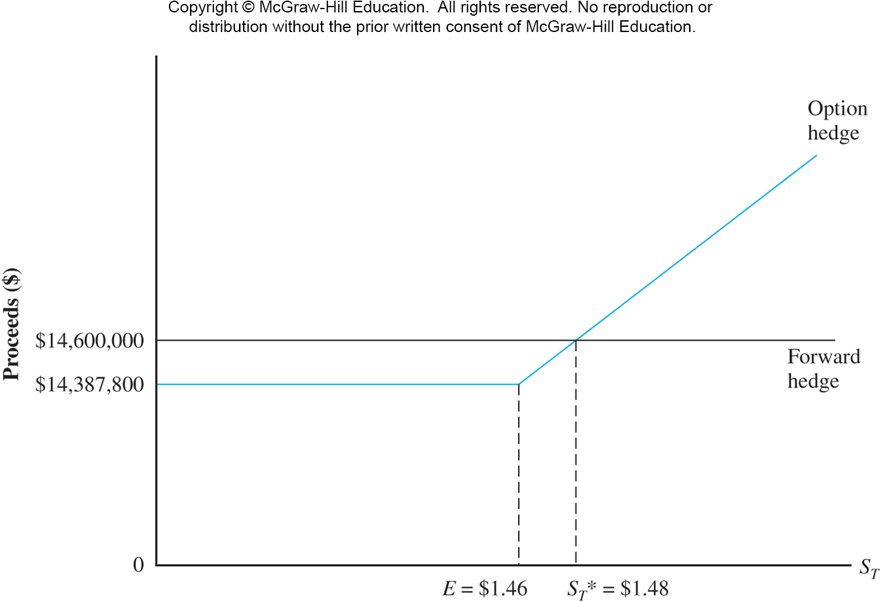
Options hedge vs. forward hedge

Slide 16
Break-even
The break-even spot (expected) in 1 year, S_{T}*, by which Boeing will be indifferent between forward hedging and option hedging is $1.48/£.
The solution is obtained by solving the following equation: ($10 million × S_{T}) - $0.2122 million = $14.6 million.
If expected future spot rate is greater (less) than the break-even rate, the options (forward) hedge may be preferred.

Slide 17
Hedging recurrent exposure with swaps
Swap contracts can be viewed as a series of forward contracts.
Firms that have recurrent exposure can usually hedge their exchange risk at a lower cost with swaps than with a program of hedging each exposure as it comes along.
Suppose that Boeing is scheduled to deliver a jet to British Airways at the beginning of the year for the next 5 years.
Boeing can enter a swap by which Boeing delivers £10 million to the swap bank each year for 5 years and take delivery of a predetermined dollar amount each year.

Slide 18
Operational hedging via invoice currency
  The firm can shift, share, or diversify:
    Shift exchange rate risk by invoicing foreign sales in home currency
    Share exchange rate risk by pro-rating the currency of the invoice between foreign and home currencies
    Diversify exchange rate risk by using a market basket index

Slide 19
Hedging via lead and lag
Lead: pay or collect early; lag: pay or collect late.
  If a currency is appreciating, pay those bills denominated in that currency early; let customers in that country pay late as long as they are paying in that currency.
  If a currency is depreciating, give incentives to customers who owe you in that currency to pay early; pay your obligations denominated in that currency as late as your contracts will allow.

Slide 20
Exposure netting
When a firm has both receivables and payables in a given foreign currency, it should consider hedging only its net exposure.
Suppose that Boeing has receivables of £10 million from British Airways, and it has payables of £5 million to Rolls-Royce. Both due around the same time. Then the net exposure is £5 million receivables.

Slide 21
Should the firm hedge?
Not everyone agrees that a firm should hedge.
  Hedging by the firm may not add to shareholder wealth if the shareholders can manage exposure themselves.
  Hedging may not reduce the non-diversifiable risk of the firm. Therefore, shareholders who hold a diversified portfolio are not benefitted when management hedges.
In the presence of market imperfections, the firm may hedge; e.g., (1) information asymmetry: The managers may have better information than the shareholders, (2) differential transactions costs: the firm may be able to hedge at better prices than the shareholders.

Slide 22
End-of-chapter
Questions: 1-7.
Problems: 1-3, 6, 7 (only a and b).

